Slide 1
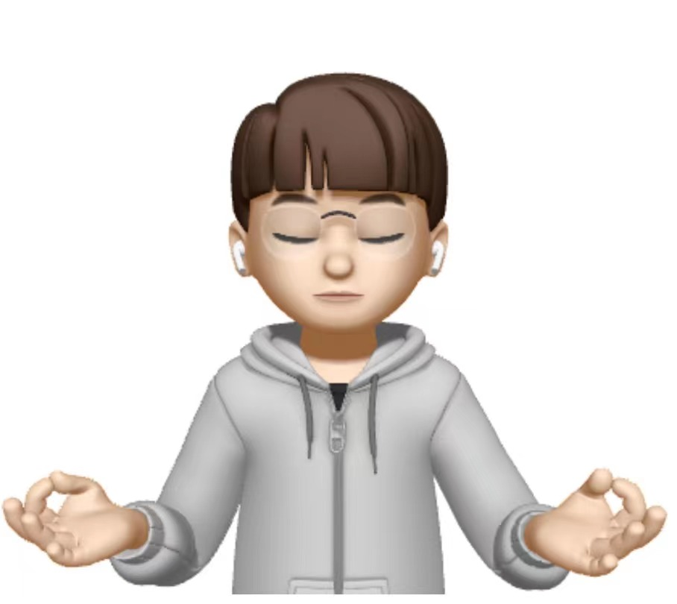
Consolidation and Retention of Motor Skill after Motor Imagery Training
Wang Lu-Yi
Doi:10.1016/j.neuropsychologia.2020.107472

Slide 2

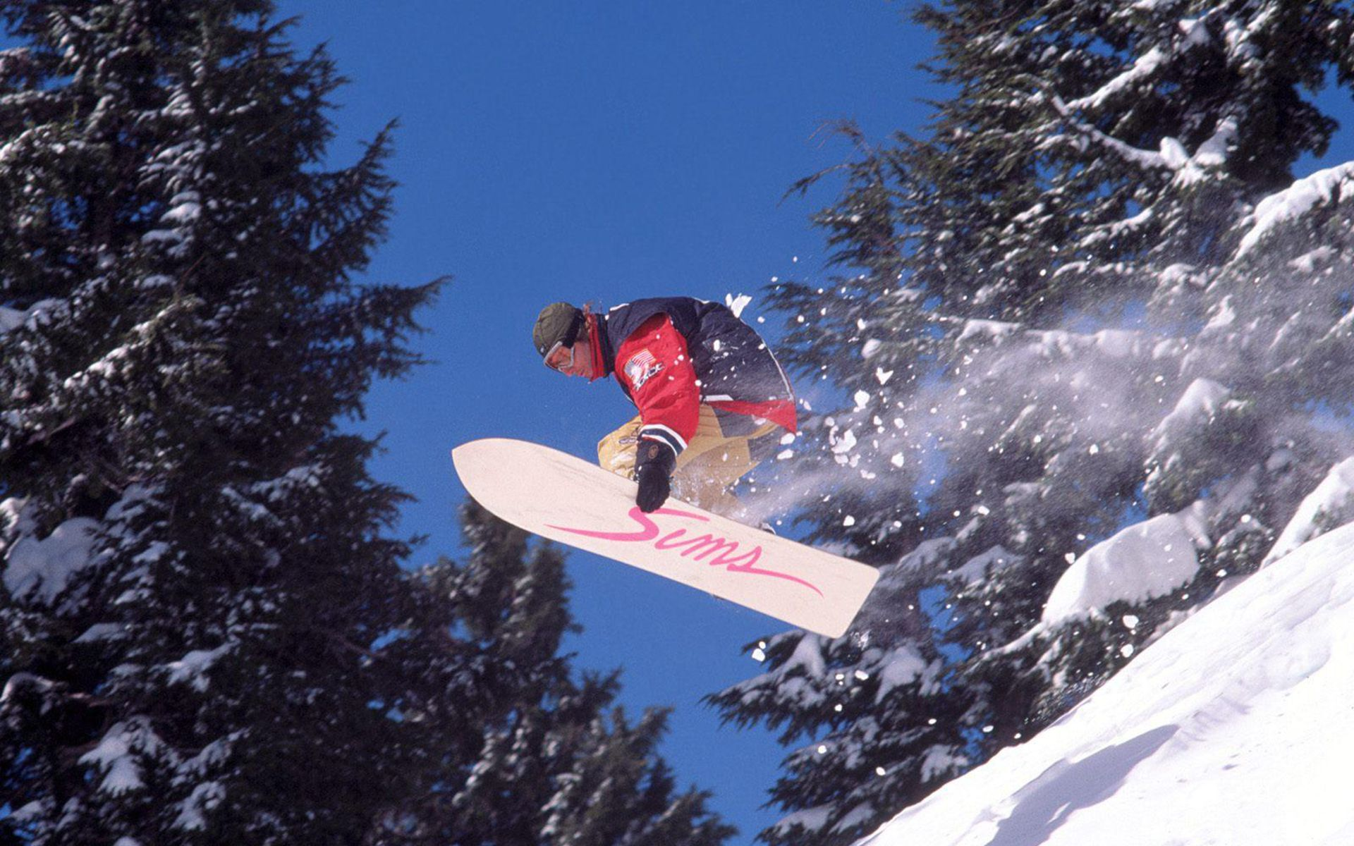
introduce

Slide 3
the cognitive processes and the neural substrates that mediate our capacity to learn follow distinct phases：
1
2
3
fast (early) learning stage
slow (later) stage and consolidation
retention stage

Slide 4
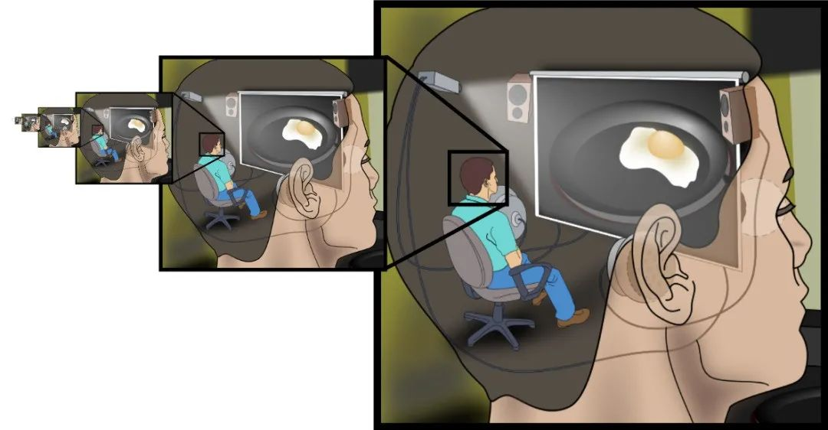
Motor Imagery (MI)

Slide 5
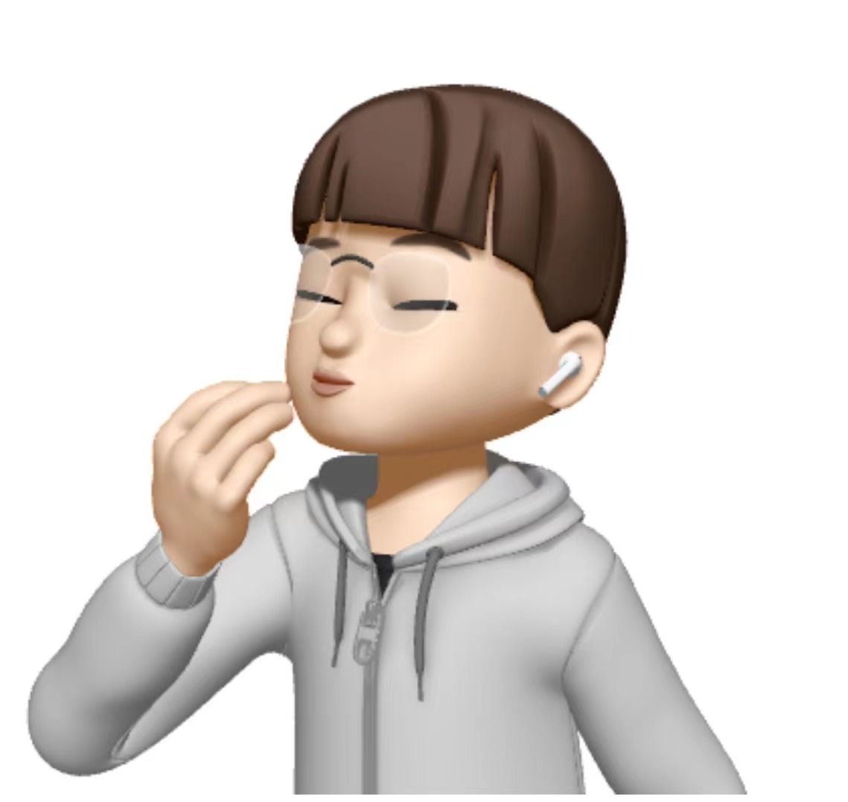

Subjects
Group | years | N
Motor Imagery (MI) | 24.27±6.3 | 12
Movement Execution(ME) | 27.30±7.2 | 12
All subjects were in good health, without any nervous, muscular, or-thopaedic or cognitive disorders.

Slide 6
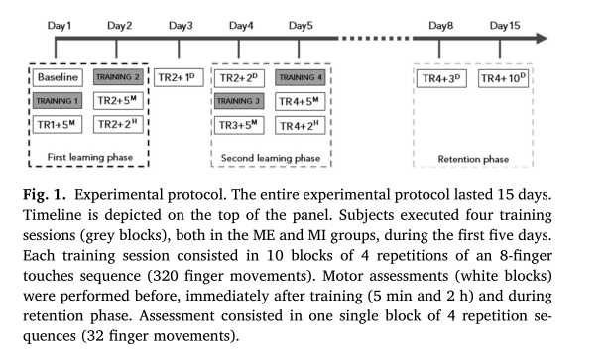

Slide 7
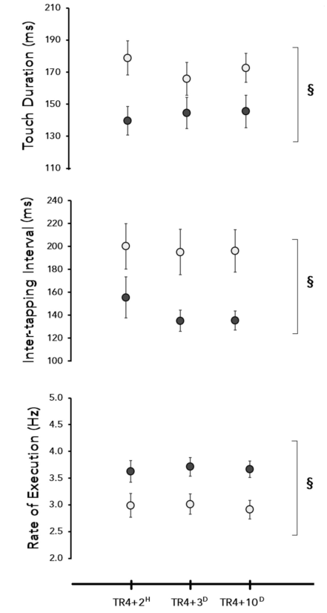
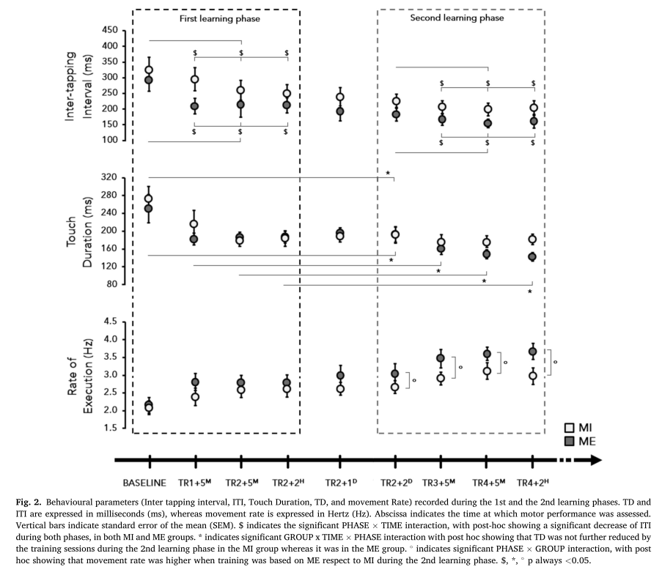

Slide 8
The main findings are the following:
(i) the time course of sensori-motor performance changes was similar for ME and MI training during the first phase of acquisition of a novel motor skill;
(ii) consolidation of motor performance improvements differed between MI and ME, with less efficient learning processes in the second learning phase for MI training;
(iii) consolidation deficits reflected in impaired retention of the acquired skills in people trained with MI.

Slide 9
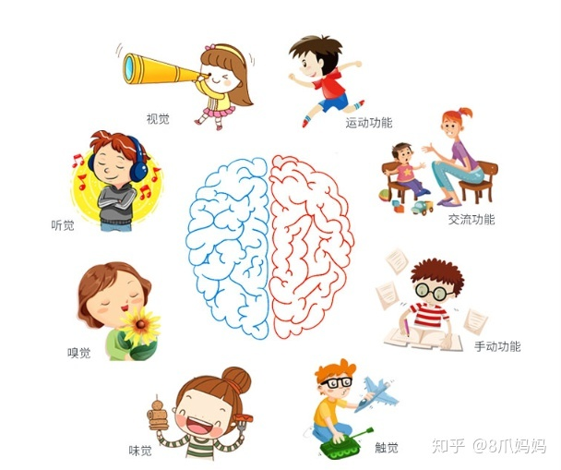
somatosensory inputs

Slide 10

Thank you for your listening!

